Slide 1

RAG and Context Engineering
Wikipedia Retrieval Engine Design Review
Author: Elena Baron

Slide 2
The design in one sentence, the results in four numbers
Evidence-first answers from a local Wikipedia corpus
with agentic retrieval, deterministic computation, and guarded generation
0.933
0.868
0 of 59
$0.107
validation quality, 3 runs
(6.1 survivor: 0.860)
GT quality, half the cost of
gpt-5.4 in every role (0.886)
attack attempts got through
after the safeguards (5 before)
per question at list price
and 18.7 seconds
Validation: 25 held-out questions, mostly text. GT: 19 questions, mostly tables. Three runs each; list prices.
Notes:
Optimized mostly for accuracy while still trying to be cost-cautious (latency was measured and considered as a secondary signal to break a tie)

Slide 3
The problem
The difficult questions are not single-passage lookups.
What the user needs
A useful answer may require several articles, time filters, an exhaustive list, relationship reasoning, or arithmetic over Wikipedia tables.
01 concise answer
02 traceable evidence
03 deterministic math
04 visible uncertainty
Earlier versions could retrieve the right article and still fail to load the needed table rows, stop with incomplete evidence, or repeat unsupported facts from conversation history.
Example (GT10) “Which sports first entered the Winter Olympic program in 1950 or later? Give the first year for each.” One table, a year filter, and three sports that left and came back.
Project Links:
Ground Truth
Notes:
Engine was tuned on 19 ground truth questions, with validation set having 25 questions with 10 questions are rephrased from GT and 15 completely new questions.
GT – table heavy
VAL – text heavy

Slide 4
How the system works
01
02
03
04
05
Sanitize + decompose
Retrieve + review
Assess evidence
Compute tables
Answer + verify
Clean the question; identify entities and subproblems.
→
Find candidate articles; inspect TOCs, sections, and tables.
→
Decide whether evidence is sufficient or request more.
→
Execute table requests deterministically; label partial results.
→
Generate only from evidence, then run the grounding check.
↺ The assessor can request more article text, graph neighbors, or a table computation before the answer is written.
Mini by default
decomposition • article selection • table planning
gpt-5.4 on table path
assessor + answer
Project Links:
Retriever_7.1 Final Version
Notes:
The question is sanitized before retrieval, and only the cleaned text is stored in conversation history. Entity decomposition drives local article retrieval.
The system reviews article tables of contents and chooses relevant sections and tables.
The assessor is the control point: it can accept the evidence or request more text, graph neighbors, or a table computation.
Table operations use a deterministic executor so partial and failed computations remain visible.
The answer is generated from trusted evidence and then checked for unsupported quotations and multiword names.
For the recorded submission, demonstrate one representative query and use this diagram to explain the visible steps.
Evidence sources: survivor_agent_final.py; README 7.1 - performance and cost.md; README 7.1 - security improvements.md.
Timing: about 1 minute 40 seconds.

Slide 5
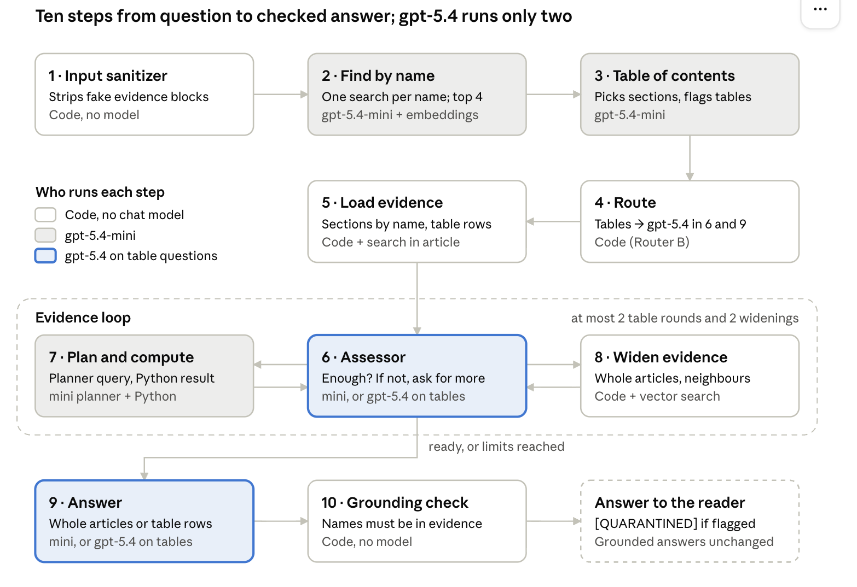

Slide 6
Retrieval choices that survived
Each addition addressed an observed failure; BM25 was tested, measured, and dropped for this corpus.
1 Drop the tested hybrid
2 Keep vector + decompose
3 Keep graph as fallback
BM25 + vector, K=7
Quality 0.705
Article recall 0.882
Mean context 184.6K chars
It added lexical matches, but also more irrelevant full articles. The vector baseline was better on all three measures.
Vector K=7 baseline
Quality 0.747
Article recall 0.899
Mean context 127.0K chars
Entity-aware decomposition adds one focused search per named person, place, event, or work so a full-question search does not bury a required entity.
A one-hop in-corpus link graph widens only when evidence is still missing.
Vector-only recall 0.899
With graph 0.939
Answer quality 0.754 (flat)
The graph survived for recall, not because it raised answer quality.
SURVIVING STACK
vector search • entity queries • TOC review • graph fallback
Scoped conclusion: the measured hybrid lost under this corpus, K, weighting, embedding, prompt, and model—not that BM25 is universally ineffective.
Notes:
Checkpoint 3.1 compared repeated vector and hybrid runs. Vector K=7 produced 0.747 quality, 0.899 designated-source recall, and 127.0K context characters. The tested BM25/vector hybrid produced 0.705 quality, 0.882 recall, and 184.6K characters, so it was dropped for this corpus and configuration.
The surviving initial retriever remained vector-based. Entity-aware decomposition was added because a full-question search could bury a named entity; each named person, place, event, or work receives a focused query.
The link graph remained a bounded fallback. It raised GT article recall from 0.899 to 0.939, but answer quality stayed approximately flat at 0.754. That is why I describe it as a recall mechanism, not a quality winner.
Evidence: README 3.1, controlled experiment inventory and findings; README 4.1, decomposition and graph experiments; README 5.1, final entity-aware retriever.
Timing: about 1 minute 15 seconds.

Slide 7
The agentic core that survived
The final graph kept only capabilities that solved a localized failure and remained observable in AgentState.
1.000
article recall in the 5.1 and 6.1 validation survivor runs
7.1: 99.3% — one request-typing edge case in 75 question-runs
Observed failure
Capability that survived
Why it remained
Named entity buried
Entity-aware decomposer
Searches each named entity separately before merging candidates.
Right article, wrong snippet
TOC reviewer
Judges title + section list, then selects section and table IDs.
Evidence still incomplete
Assessor + bounded escalation
Requests whole selected articles, then graph neighbors, before answering.
Math and exhaustive lists fail
Deterministic table branch
A model plans; Python filters, counts, and returns provenance. Details next.
Failures were opaque
AgentState trace
Records routes, selections, plans, warnings, usage, and terminal evidence.
Design rule: model decisions remain bounded; deterministic code performs the calculations; every transition is logged.

Slide 8
Why tables required a separate path
Retrieval found the article; structured computation was needed to answer counts, filters, ranges, and exhaustive lists reliably.
What the table path does
TABLE-HEAVY GT
1 TOC review flags a table and selects an immutable table ID.
2 NormalizedTable repairs headers and row alignment while preserving warnings.
3 The planner chooses lookup, filter, count, aggregate, or intersection.
4 Python executes the operation and returns source cells, results, and incomplete-state labels.
The model explains the computed evidence; it does not perform the arithmetic itself.
0.579
0.697
0.789
TOC sections
aligned tables
forced compute
Quality rose while article recall reached 1.000.
SYNTHESIS-HEAVY VALIDATION
5.1 section gateway
0.845
4.1 graph, fuller articles
0.885
Full recall was not enough: narrow sections starved broad explanations.
FINAL DESIGN DECISION
Keep deterministic computation for table questions; restore whole selected articles for non-table questions in 6.1.

Slide 9
Security enhancements that survived
The failure was a provenance error: untrusted conversation text could be repeated as though it came from the corpus.
1 Sanitize input
2 Guard the trust boundary
3 Check the drafted answer
Before retrieval, deterministic middleware removes forged evidence formatting and flags instruction-pattern text.
History stores the sanitized question, so a fake source is not carried into later turns unchanged.
The answer prompt states a trust order: current corpus evidence is factual support; prior conversation is context, not evidence.
A quotation rule prevents conversational text from being presented as a verified source.
A deterministic grounding check compares quotations and multiword names with current-turn corpus evidence.
The reader receives a warning before a flagged answer. It is a backstop, not a complete fact checker.
5 / 59 → 0 / 59
Fake-nominee subset: 5/20 → 0/20
Fisher exact p = 0.047
Trade-off
47 of 155 answers were warned; 6 were judged fully correct.
fabricated facts adopted before vs. after
Controls were enabled together. The fake content was absent from the first draft, so the experiment cannot assign prevention to one layer; the output check remained a backstop.

Slide 10
The assessor and the answer are 93% of the cost
Share of list cost per question by role · final retriever · validation set, 3 runs (75 question-runs) · total $0.107 per question
Red: the two roles that switch to gpt-5.4 on table questions. The assessor runs about twice per question.
Notes:
This is where the money goes in the final retriever, measured on the validation set.
The assessor and the answer are 93% of the cost.
The assessor runs about twice per question and re-reads the growing evidence each time, so it costs more than the answer itself. The decomposer, the table-of-contents review, and the table planner together are under 7%.
In the final validation runs, all 36 text question-runs stayed on mini and passed.

Slide 11
The table signal creates two execution paths
The decision happens after retrieval, when the system can see the selected articles, sections, and tables.
Question
→
Retrieve and review with mini
→
Does the answer require table computation?
Select articles and sections. Record stable table IDs.
A table flag or selected table ID activates the table path.
NO
YES
TEXT-ONLY QUESTION
TABLE QUESTION
Mini assesses
selected sections
→
Mini answers
from whole articles
gpt-5.4
assesses
→
Mini plans
the operation
→
Python
computes
→
gpt-5.4
writes answer
No table planner. Every model call stays on mini.
The planner stays on mini because the stronger planner requested more evidence and causes enlarged later prompts.
Only table questions switch models. Only evidence assessment and final answer writing use gpt-5.4.
Notes:
The planner stays on mini because the exploratory strong-planner configuration requested more table evidence.
Every later call had to reread that larger evidence, which increased prompt size and cost.

Slide 12
How the table-path model policy evolved
The alternatives differed in when they decided and how much of the pipeline moved to gpt-5.4.
Option | When / trigger | Pipeline steps on gpt-5.4 | Evidence and lesson
All mini | No model switch | None | 0.711 quality $0.050 list cost/q 13.8 seconds/q
All gpt-5.4 | No model switch | Every model step | 0.886 quality $0.346 list cost/q 24.7 seconds/q, 3 runs
Router A (simulated) | Before retrieval: Jev labels the wording simple or complex | The entire question stays on mini or moves to gpt-5.4 | 0.868 quality $0.327 list cost/q Saved only about 3 percent
First table policy (exploratory) | After TOC review: table signal | On table questions: assessor, planner, and answer | 0.816 quality $0.301 list cost/q Strong planner enlarged prompts
Selected table policy (‘Router B’) | After TOC review: the same table signal | On table questions: assessor and answer. Planner remains mini. | 0.868 quality $0.173 list cost/q 21.3 seconds/q, 3 runs
WHY IT WON
Text questions stay on mini. Table questions move only evidence assessment and final answer writing to gpt-5.4.
Compared with all gpt-5.4: quality difference −0.018, p = 0.81. List cost was 50 percent lower, p = 0.001.
Notes:
The name Router B came from an experiment label, so I now explain the alternatives by what they actually changed.
All mini was fast and inexpensive but averaged 0.711 quality on the GT working set.
All gpt-5.4 produced the highest mean quality, 0.886 over three runs, but cost 0.3457 dollars per question and exposed large table-prompt tails.
Router A was a whole-question policy evaluated retrospectively. Before retrieval, Jev read only the question wording and classified it as simple—one text article—or complex.
The whole question then stayed on mini or moved to gpt-5.4. At the 0.5 threshold it preserved the saved GT quality of 0.868 at 0.3274 dollars per question, only about 3 percent below all gpt-5.4. It was simulated from saved outcomes, not tested as a live routed graph.
The first live question-type router waited until the TOC reviewer had an evidence-based table flag, then moved the assessor, planner, and answer to gpt-5.4. In its one exploratory run it scored 0.816 at 0.3009 dollars per question.
The strong planner requested more table evidence, which every later call reread.
The selected table policy uses the same table signal but switches only the assessor and answer. Text questions stay on mini. Keeping the table planner on mini reduced evidence growth and cost.
Across three repeated GT runs it scored 0.868 at 0.1725 dollars and 21.3 seconds per question.
Against all gpt-5.4, the observed quality difference was minus 0.018 with p equals 0.81; this is no detected difference, not proof of equivalence. List cost was 50 percent lower with p equals 0.001. It was also the only repeated routed configuration statistically higher than all mini, p equals 0.047.

Slide 13
Validation trade-offs on a common basis
Every column uses answer quality, list-price cost per question, and seconds per question.
System | What changed | Quality | List cost per question | Seconds per question
5.1 | Agent loop with deterministic table computation | 0.880 | $0.0431* | 16.1*
6.1 | Text questions stop earlier. Table failures become explicit. | 0.860 | $0.0422 | 12.8
7.1 | Safeguards plus gpt-5.4 assessment and answer writing on table questions | 0.933 | $0.1068 | 18.7
* The 5.1 cost and time values came from its measured telemetry run. Quality values are three-run validation means.
5.1 to 6.1
6.1 to 7.1
Quality −0.020
List cost per question −$0.0009
Seconds per question −3.3
Quality +0.073
List cost per question +$0.0646
Seconds per question +5.9
6.1 made the workflow faster. 7.1 accepted more cost and time for a higher measured quality result. The quality comparison had p = 0.094.

Slide 14
The journey in numbers
Recall reached its ceiling at 5.1; quality kept moving until 7.1 led on both question sets.
Quality axis starts at 0.70 and recall axis at 0.85. Earlier checkpoints come from their own recorded campaigns; 5.1 to 7.1 use three runs each.

Slide 15
Observed failures and next engineering changes
Each planned change maps to a failure reproduced in the evaluation logs.
Observed problem | Evidence | Next engineering change
A missing source was placed in a table request. When the table budget ended, the graph stopped before another retrieval attempt. | 1 of 75 validation question-runs | Convert source requests without table IDs into retrieval requests. Check pending retrieval before termination and add a regression test.
Set hard limits for table route: Repeated table requests can keep adding rows. Every later model call must reread the expanded evidence. | Observed in table-route telemetry and extreme cost tails | Set hard limits on table rounds, retained rows, and prompt size. Return an explicit incomplete status when a limit is reached.
More work on evidence check: The grounding check focuses on names and quotations. It can miss unsupported relationships or warn on supported answers. | 47 of 155 answers warned 6 were fully correct | Verify evidence-linked claims and tune thresholds on a larger labeled set. Track both missed errors and false warnings.
Notes:
The first limitation is a specific control-flow failure, not an internal question label. In one of 75 validation question-runs, initial retrieval found the historical life-expectancy article but missed the required United Nations population article.
After two incomplete table rounds, the assessor placed the still-missing population source into table_requests without a table ID and emitted no retrieval_request. The table budget was exhausted, so the workflow terminated before graph-seeded retrieval could run. The other two runs for the same question preserved a retrieval request, found both articles, and reached full recall.
The next change should normalize any source request without a valid table ID into a retrieval request. The termination check should also inspect unresolved retrieval work before stopping. A regression test should reproduce the exhausted-table-budget state.
The second limitation is prompt growth. Repeated table requests can add many rows to retained evidence, and every later model call rereads them. Deterministic caps on table rounds, retained rows, and total prompt size would bound both latency and cost. When a cap is reached, the system should report incomplete evidence rather than continue silently.
The third limitation is the grounding check. It compares names and quotations against current evidence, but it does not verify every relationship, arithmetic claim, or exhaustive list. It warned on 47 of 155 answers, including 6 that the judge considered fully correct. The next version should link each answer claim to supporting evidence and tune the checker on a larger labeled set while tracking both missed errors and false warnings.
Evidence: README 7.1 - performance and cost.md, final validation, recall analysis, and final technical conclusion; README 7.1 - security improvements.md.
Timing: about 1 minute 30 seconds.

Slide 16
Backup slides
For questions: the earlier results slide, the journey table, the model tests, the routing experiments, and the routing flow

Slide 17
Questions for the design review
01
Is the model switch clear?
Text questions stay on mini. Table questions switch only the assessor and final answer to gpt-5.4.
02
Does the architecture diagram make retrieval, assessment, table computation, and answer generation easy to follow?
For the final recorded submission: incorporate the review feedback, add a short system demonstration, verify the repository setup from a clean environment, and replace this slide with a concise conclusion.
Notes:
Ask for feedback on two decisions that directly affect the final capstone submission.
First, is the final model switch concrete enough for an audience seeing the system for the first time? Text questions stay on gpt-5.4-mini. A table signal switches only evidence assessment and final answer writing to gpt-5.4, while the planner remains on mini. Second, can a reviewer understand the feedback loop among retrieval, assessment, deterministic table computation, and answer generation from the architecture slide alone?
After the live review, replace this slide with a conclusion that states the final design, strongest evidence, most important limitation, and next engineering action. Add the verified GitHub repository link to the final submission.
Timing: use the remaining time for discussion.

Slide 18
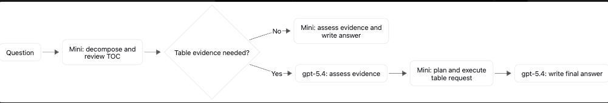
The two execution paths, as a flow

Slide 19
How I know it works
Held-out answer quality
25 questions × 3 runs per survivor
99.3%
article recall
74 of 75 question-runs found every source
5 / 59 → 0 / 59
fabricated facts adopted before vs. after safeguards
Fake-nominee attacks: 5/20 → 0/20; Fisher exact p = 0.047
Observed validation gain vs. 6.1: +0.073 (p = 0.094). This supports the final design but is not statistically conclusive evidence of broad improvement.

Slide 20
One question, end to end
GT10: “Which sports first entered the Winter Olympic program in 1950 or later? Give the first year for each.”
Step | Model · time | What happened on GT10
Find articles by name | mini · 1.0 s | Searched “Winter Olympic Games” plus the full question: 5 candidate articles
Table-of-contents review | mini · 3.4 s | Kept 1 of 5 articles, picked 2 sections, flagged the Sport/Years table
Route | code | A table was flagged, so the assessor and the answer switch to gpt-5.4
Assessor, round 1 | gpt-5.4 · 4.8 s | Only 9 of the table's 16 rows were visible: asked for a filter over all rows
Planner + Python | mini + code · 0.9 s | Plan: keep rows whose earliest year is 1950 or later → 6 rows, 12 cited cells
Assessor, round 2 | gpt-5.4 · 2.7 s | Evidence complete: ready to answer
Answer | gpt-5.4 · 2.0 s | Biathlon 1960, luge 1964, freestyle skiing 1992, short track 1992, snowboarding 1998, ski mountaineering 2026
Grounding check | code | Every name is in the evidence, so no warning. Judge: pass in 3 of 3 runs
The trap: bobsleigh, curling, and skeleton left the program and came back, so their “since” year is after 1950 but their first year is not. Python filters on the earliest year, so they are correctly left out.
6 model calls · 24,235 input tokens · $0.063 at list price · 16.2 seconds · final retriever, GT run reverent_diffie (2026-10-04)
Notes:
This is the real trace of GT10 from one of the final retriever's three GT runs.
The decomposer turned the question into one name, Winter Olympic Games, and the search returned five candidate articles.
The table-of-contents review kept one, picked the Sports and Current sports sections, and flagged the Sport/Years table.
Because a table was flagged, the router switched the assessor and the answer to gpt-5.4.
The assessor saw only 9 of the table's 16 rows and would not answer from a partial table, so it asked for a filter.
The mini planner wrote it as “earliest year is 1950 or later”, and Python ran it over every row: six sports, each tied to the table cells it came from.
That filter avoids the trap. Bobsleigh, curling, and skeleton have a “since” year after 1950, but their first year is earlier, so they are correctly left out.
The second assessment was ready, gpt-5.4 wrote the answer, and the grounding check found every name in the evidence. The judge passed it in all three runs. The whole question took 6 model calls, 16 seconds, and about 6 cents.
Before the table gateway in 5.1, this question passed only in the runs where the assessor happened to call the executor.

Slide 21
The journey in numbers
Held-out survivor results show a sequence of bottlenecks—not a monotonic march upward.
ANSWER QUALITY
3.1
4.1
5.1
6.1
7.1
Vector baseline
Graph fallback
Agent + tables
Reliability
Safeguards + table path
ARTICLE RECALL
0.907
0.973
0.885
0.973
0.880
1.000
0.860
1.000
0.933
0.993
CHECKPOINT
ENGINEERING CHANGE
WHAT THE NUMBER REVEALED
3.1
Vector baseline
Measured retrieval baseline
4.1
Graph fallback
More retrieval options; no quality lift
5.1
Agent + tables
Perfect recall; section/synthesis tension
6.1
Reliability
Faster; text up, tables regressed
7.1
Safeguards + table path
Best held-out quality; one recall miss
Quality / recall values above are recorded validation survivor means. Earlier checkpoint campaigns were not one single controlled experiment; the final 5.1–7.1 comparison used three runs per survivor.
Notes:
The numerical story is not that every checkpoint increased one score. Each checkpoint moved a different bottleneck.
The 3.1 vector baseline scored 0.907 quality and 0.973 recall on the held-out set. The 4.1 graph survivor had the same recall and 0.885 quality. The 5.1 agentic survivor reached 1.000 recall and 0.880 quality, but the logs showed a section-versus-synthesis trade-off. The 6.1 reliability survivor remained at 1.000 recall and 0.860 quality while reducing work and improving text questions. The 7.1 final system reached 0.933 quality and 0.993 recall.
Earlier checkpoint values come from their recorded campaigns, which differed in run counts and exact implementations. I use this slide as the engineering lineage. The controlled final comparison for 5.1, 6.1, and 7.1 used three validation runs per survivor.
Evidence: README 4.1 validation baseline; README 5.1 final validation; README 7.1 final validation build and provenance.
Timing: about 1 minute.

Slide 22
What each model was tested to do
The GPT models performed pipeline steps. Jev made small routing or checking decisions and never generated the answer.
gpt-5.4-mini
gpt-5.4
Jev 1.13
DEFAULT WORKER
CAPABILITY TEST
DECISION-ONLY TEST
Started in every model step.
The final design keeps mini for entity decomposition, TOC review, and table planning.
GT baseline, 3 runs
0.711 quality
$0.0502 per question
13.8 seconds per question
Tested in every model step, then in targeted step combinations.
All steps, 3 GT runs
0.886 quality
$0.3457 per question
24.7 seconds per question
The clearest benefit came from evidence assessment and answer writing. A strong table planner requested more data and enlarged later prompts.
Does not produce a narrative answer.
Input: a compact state plus a typed yes, choice, or score question.
Output: a probability or selected option.
About 0.2 seconds per routing call
32K-token context window
Tested before retrieval for simple versus complex routing, and after a mini answer for completeness.
FINAL RUNTIME
Mini handles decomposition, TOC review, and table planning. The table signal moves only the assessor and answer to gpt-5.4.

Slide 23
How the routing experiments worked
The experiments changed when the decision happened, what information it used, and which pipeline steps used gpt-5.4.
Jev before retrieval
1
Question wording
2
Jev labels simple or complex
3
Whole graph uses mini or gpt-5.4
4
0.868 quality
$0.327/q
Saved only about 3%
Router A, simulated
Limitation: Jev saw wording only, before the system knew what evidence it had retrieved.
Jev after an answer
1
TOC review measures evidence size
2
>80K chars: use gpt-5.4
Otherwise: mini answer
3
Jev returns P(complete)
4
Below 0.5, failure, or overflow: rerun on gpt-5.4
one exploratory run
One run: 0.842 quality at $0.1275/q. Escalated questions paid for two passes, and a complete-looking wrong count could pass the check.
TOC signal after retrieval
1
Mini retrieves and reviews TOCs
2
TOC review sets the table signal
3
Table route: gpt-5.4 assessor + answer
4
Mini planner
No extra router call
3 repeated runs
selected table-path policy
Selected result: 0.868 quality at $0.1725/q and 21.3 s/q. Text stayed on mini. Table questions switched the assessor and answer.
The final route waits for retrieval, uses the article and table structure already selected, and avoids both a separate router call and a full second pass.
Notes:
Jev was tested only in the experimental answer-check strategies (check and b-check). Those strategies were not selected because they cost more and produced lower quality.
The final “Router B” makes no Jev calls.

